Slide 1
Student Growth Percentiles (SGP): A Comparison of Legislative Intent with Implemented Results at one Utah School (Timpanogos Academy)

Slide 2
Benchmarks, Old & New:
Benchmark 1: Nationwide Comparisons

Slide 3
Section 1: 3rd Grade Iowa Tests Comparison
Note: Alpine School District stopped administering ITBS after 2008-09, and the State of Utah stopped after 2009-10

Slide 4
Section 1: 3rd Grade Iowa Tests Comparison
Note: Alpine School District stopped administering ITBS after 2008-09, and the State of Utah stopped after 2009-10

Slide 5
Section 1: 5th Grade Iowa Tests Comparison
Note: Alpine School District stopped administering ITBS after 2008-09, and the State of Utah stopped after 2009-10

Slide 6
Section 1: 5th Grade Iowa Tests Comparison
Note: Alpine School District stopped administering ITBS after 2008-09, and the State of Utah stopped after 2009-10

Slide 7
Section 1: 8th Grade Iowa Tests Comparison
Note: Alpine School District stopped administering ITBS after 2008-09, and the State of Utah stopped after 2009-10

Slide 8
Section 1: 8th Grade Iowa Tests Comparison
Note: Alpine School District stopped administering ITBS after 2008-09, and the State of Utah stopped after 2009-10

Slide 9
Benchmarks, Old & New:
Benchmark 1: Nationwide Comparisons
Section 2: Direct Writing Assessments (DWA)
Benchmark 2: State CRT Proficiency Levels

Slide 10
Class of 2012 – Language Arts CRT Proficiency Levels

Slide 11
Class of 2012 – Math CRT Proficiency Levels

Slide 12
Class of 2012 – Science CRT Proficiency Levels
2m

Slide 13
Benchmarks, Old & New:
Benchmark 1: Nationwide Comparisons
Benchmark 2: State CRT Proficiency Levels
Benchmark 3: Dibels Reading

Slide 14
School District | % at Grade Level
1 (tie) – Wellenman School of Discovery Summitt Academy | 95%
3 – Timpanogos Academy | 94%
4 (tie) – George Washington Academy Liberty Academy Tintic District | 93%
7 – Daggett District | 91%
--- --- --- --- --- --- --- --- --- --- ---
61 – Alpine District | 72%

Slide 15
Benchmarks, Old & New:
Benchmark 1: Nationwide Comparisons
Benchmark 2: State CRT Proficiency Levels
Benchmark 3: Dibels Reading
Benchmark 4: Grading Utah Schools (GUS)

Slide 16
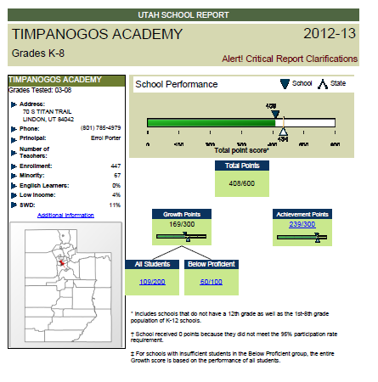

Slide 17
Some of the grades this year may surprise you. If that happens, the question to ask is, "Why did this school receive this grade?" As you dig deeper, the answers should be illuminating.

Slide 18
Legislative Intent

Slide 19
Legislative Intent
This policy was patterned after the Florida Model which has helped propel significant student achievement gains

Slide 20
Legislative Intent
This policy was patterned after the Florida Model which has helped propel significant student achievement gains
The growth component requires schools to demonstrate that all students, high achieving and low achieving, have made a year’s worth of progress in a year’s time.

Slide 21
Legislative Intent
This policy was patterned after the Florida Model which has helped propel significant student achievement gains
The growth component requires schools to demonstrate that all students, high achieving and low achieving, have made a year’s worth of progress in a year’s time.
For a school to get credit, students need to achieve at least a year's worth of learning in the school year; less than that means the student has fallen further behind.

Slide 22
Legislative Intent
This policy was patterned after the Florida Model which has helped propel significant student achievement gains
The growth component requires schools to demonstrate that all students, high achieving and low achieving, have made a year’s worth of progress in a year’s time.
For a school to get credit, students need to achieve at least a year's worth of learning in the school year; less than that means the student has fallen further behind.
The growth component is meant to incentivize schools to get students at grade level and keep them there.

Slide 23
Legislative Intent
This policy was patterned after the Florida Model which has helped propel significant student achievement gains
The growth component requires schools to demonstrate that all students, high achieving and low achieving, have made a year’s worth of progress in a year’s time.
For a school to get credit, students need to achieve at least a year's worth of learning in the school year; less than that means the student has fallen further behind.
The growth component is meant to incentivize schools to get students at grade level and keep them there.
In Florida’s model, growth can be achieved in two ways:
1) If a student is below grade level, the school gets credit for moving him towards grade level.
2) If a students is already at grade level or higher, all a school must do is keep that student at grade level the next year. 3) That’s because a year’s worth of learning gains has taken place.
4m

Slide 24
Legislative Intent
This policy was patterned after the Florida Model which has helped propel significant student achievement gains
The growth component requires schools to demonstrate that all students, high achieving and low achieving, have made a year’s worth of progress in a year’s time.
For a school to get credit, students need to achieve at least a year's worth of learning in the school year; less than that means the student has fallen further behind.
The growth component is meant to incentivize schools to get students at grade level and keep them there.
Scale Scores: 130 to 199
In Florida’s model, growth can be achieved in two ways:
1) If a student is below grade level, the school gets credit for moving him towards grade level.
2) If a students is already at grade level or higher, all a school must do is keep that student at grade level the next year. 3) That’s because a year’s worth of learning gains has taken place.
168 to 199: Advanced Proficiency:
160 to 167: Proficient:
153 to 159: Not Proficient, Level 2 130 to 152: Not Proficient, Level 1
____________________________

Slide 25
Legislative Intent
This policy was patterned after the Florida Model which has helped propel significant student achievement gains
TB 5th LA = 174 6th LA = 175
NN 5th LA = 174 6th LA = 175
The growth component requires schools to demonstrate that all students, high achieving and low achieving, have made a year’s worth of progress in a year’s time.
For a school to get credit, students need to achieve at least a year's worth of learning in the school year; less than that means the student has fallen further behind.
The growth component is meant to incentivize schools to get students at grade level and keep them there.
Scale Scores: 130 to 199
In Florida’s model, growth can be achieved in two ways:
1) If a student is below grade level, the school gets credit for moving him towards grade level.
2) If a students is already at grade level or higher, all a school must do is keep that student at grade level the next year. 3) That’s because a year’s worth of learning gains has taken place.
168 to 199: Advanced Proficiency:
160 to 167: Proficient:
153 to 159: Not Proficient, Level 2 130 to 152: Not Proficient, Level 1
____________________________

Slide 26
Legislative Intent
This policy was patterned after the Florida Model which has helped propel significant student achievement gains
TB 5th LA = 174 6th LA = 175
NN 5th LA = 174 6th LA = 175
The growth component requires schools to demonstrate that all students, high achieving and low achieving, have made a year’s worth of progress in a year’s time.
SGP: 55 (+)
For a school to get credit, students need to achieve at least a year's worth of learning in the school year; less than that means the student has fallen further behind.
The growth component is meant to incentivize schools to get students at grade level and keep them there.
Scale Scores: 130 to 199
In Florida’s model, growth can be achieved in two ways:
1) If a student is below grade level, the school gets credit for moving him towards grade level.
2) If a students is already at grade level or higher, all a school must do is keep that student at grade level the next year. 3) That’s because a year’s worth of learning gains has taken place.
168 to 199: Advanced Proficiency:
160 to 167: Proficient:
153 to 159: Not Proficient, Level 2 130 to 152: Not Proficient, Level 1
____________________________

Slide 27
Legislative Intent
This policy was patterned after the Florida Model which has helped propel significant student achievement gains
TB 5th LA = 174 6th LA = 175
NN 5th LA = 174 6th LA = 175
The growth component requires schools to demonstrate that all students, high achieving and low achieving, have made a year’s worth of progress in a year’s time.
SGP: 55 (+)
SGP: 38 (-)
For a school to get credit, students need to achieve at least a year's worth of learning in the school year; less than that means the student has fallen further behind.
The growth component is meant to incentivize schools to get students at grade level and keep them there.
Scale Scores: 130 to 199
In Florida’s model, growth can be achieved in two ways:
1) If a student is below grade level, the school gets credit for moving him towards grade level.
2) If a students is already at grade level or higher, all a school must do is keep that student at grade level the next year. 3) That’s because a year’s worth of learning gains has taken place.
168 to 199: Advanced Proficiency:
160 to 167: Proficient:
153 to 159: Not Proficient, Level 2 130 to 152: Not Proficient, Level 1
____________________________

Slide 28
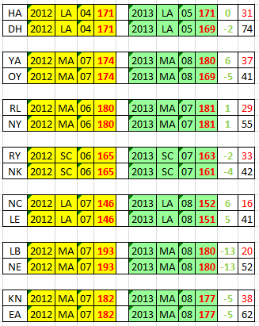
Legislative Intent
This policy was patterned after the Florida Model which has helped propel significant student achievement gains
The growth component requires schools to demonstrate that all students, high achieving and low achieving, have made a year’s worth of progress in a year’s time.
For a school to get credit, students need to achieve at least a year's worth of learning in the school year; less than that means the student has fallen further behind.
The growth component is meant to incentivize schools to get students at grade level and keep them there.
In Florida’s model, growth can be achieved in two ways:
1) If a student is below grade level, the school gets credit for moving him towards grade level.
2) If a students is already at grade level or higher, all a school must do is keep that student at grade level the next year. 3) That’s because a year’s worth of learning gains has taken place.

Slide 29
TB 5th LA = 174 6th LA = 175
NN 5th LA = 174 6th LA = 175
SGP: 55 (+)
SGP: 38 (-)

Slide 30
TB 5th LA = 174 6th LA = 175
NN 5th LA = 174 6th LA = 175
SGP: 55 (+)
SGP: 38 (-)

Slide 31
TB 5th LA = 174 6th LA = 175
NN 5th LA = 174 6th LA = 175
SGP: 55 (+)
SGP: 38 (-)
Multiple Trajectories? “COMPLEX ALGORITHYM” from “R” Program

Slide 32
Multiple Trajectories? “COMPLEX ALGORITHYM” from “R” Program

Slide 33
Legislative Intent: “Transparency of the calculation is vital; processes and rules need to be clearly articulated and publicly available.”
Multiple Trajectories? “COMPLEX ALGORITHYM” from “R” Program

Slide 34
Legislative Intent: “Transparency of the calculation is vital; processes and rules need to be clearly articulated and publicly available.”
Multiple Trajectories? “COMPLEX ALGORITHYM” from “R” Program

Slide 35
Legislative Intent
This policy was patterned after the Florida Model which has helped propel significant student achievement gains
The growth component requires schools to demonstrate that all students, high achieving and low achieving, have made a year’s worth of progress in a year’s time.
For a school to get credit, students need to achieve at least a year's worth of learning in the school year; less than that means the student has fallen further behind.
The growth component is meant to incentivize schools to get students at grade level and keep them there.
In Florida’s model, growth can be achieved in two ways:
1) If a student is below grade level, the school gets credit for moving him towards grade level.
2) If a students is already at grade level or higher, all a school must do is keep that student at grade level the next year. 3) That’s because a year’s worth of learning gains has taken place.

Slide 36
Legislative Intent
This policy was patterned after the Florida Model which has helped propel significant student achievement gains
The growth component requires schools to demonstrate that all students, high achieving and low achieving, have made a year’s worth of progress in a year’s time.
For a school to get credit, students need to achieve at least a year's worth of learning in the school year; less than that means the student has fallen further behind.
The growth component is meant to incentivize schools to get students at grade level and keep them there.
In Florida’s model, growth can be achieved in two ways:
1) If a student is below grade level, the school gets credit for moving him towards grade level.
2) If a students is already at grade level or higher, all a school must do is keep that student at grade level the next year. 3) That’s because a year’s worth of learning gains has taken place.

Slide 37
Legislative Intent
This policy was patterned after the Florida Model which has helped propel significant student achievement gains
The growth component requires schools to demonstrate that all students, high achieving and low achieving, have made a year’s worth of progress in a year’s time.
For a school to get credit, students need to achieve at least a year's worth of learning in the school year; less than that means the student has fallen further behind.
The growth component is meant to incentivize schools to get students at grade level and keep them there.
In Florida’s model, growth can be achieved in two ways:
1) If a student is below grade level, the school gets credit for moving him towards grade level.
2) If a students is already at grade level or higher, all a school must do is keep that student at grade level the next year. 3) That’s because a year’s worth of learning gains has taken place.

Slide 38
Legislative Intent
This policy was patterned after the Florida Model which has helped propel significant student achievement gains
The growth component requires schools to demonstrate that all students, high achieving and low achieving, have made a year’s worth of progress in a year’s time.
For a school to get credit, students need to achieve at least a year's worth of learning in the school year; less than that means the student has fallen further behind.
The growth component is meant to incentivize schools to get students at grade level and keep them there.
In Florida’s model, growth can be achieved in two ways:
1) If a student is below grade level, the school gets credit for moving him towards grade level.
2) If a students is already at grade level or higher, all a school must do is keep that student at grade level the next year. 3) That’s because a year’s worth of learning gains has taken place.

Slide 39
Legislative Intent
This policy was patterned after the Florida Model which has helped propel significant student achievement gains
The growth component requires schools to demonstrate that all students, high achieving and low achieving, have made a year’s worth of progress in a year’s time.
For a school to get credit, students need to achieve at least a year's worth of learning in the school year; less than that means the student has fallen further behind.
The growth component is meant to incentivize schools to get students at grade level and keep them there.
In Florida’s model, growth can be achieved in two ways:
1) If a student is below grade level, the school gets credit for moving him towards grade level.
2) If a students is already at grade level or higher, all a school must do is keep that student at grade level the next year. 3) That’s because a year’s worth of learning gains has taken place.

Slide 40
Legislative Intent
This policy was patterned after the Florida Model which has helped propel significant student achievement gains
The growth component requires schools to demonstrate that all students, high achieving and low achieving, have made a year’s worth of progress in a year’s time.
For a school to get credit, students need to achieve at least a year's worth of learning in the school year; less than that means the student has fallen further behind.
The growth component is meant to incentivize schools to get students at grade level and keep them there.
In Florida’s model, growth can be achieved in two ways:
1) If a student is below grade level, the school gets credit for moving him towards grade level.
2) If a students is already at grade level or higher, all a school must do is keep that student at grade level the next year. 3) That’s because a year’s worth of learning gains has taken place.

Slide 41
Therefore, what ???
“I believe such a system is necessary for teachers and administrators to focus their efforts, for parents to understand what¹s happening at their children's schools, and for board members and lawmakers to evaluate policy changes and reallocate resources effectively.”

Slide 42
Therefore, what ???
Growth shows success in the education system because it shows us where positive change is happening for students and schools.
7m

Slide 43
Therefore, what ???
Growth shows success in the education system because it shows us where positive change is happening for students and schools.
TB 5th LA = 174 6th LA = 175
NN 5th LA = 174 6th LA = 175
SGP: 55 (+)
SGP: 38 (-)

Slide 44
Therefore, what ???
Growth shows success in the education system because it shows us where positive change is happening for students and schools.
Florida’s model places the most emphasis on the lowest performing students in a school.

Slide 45
Therefore, what ???
Growth shows success in the education system because it shows us where positive change is happening for students and schools.
Timp | Scale Score | 2012-13
Advanced | 168-199 | 353 (54.2%)
Proficient | 160-167 | 161 (24.6%)
Below 1 | 153-159 | 78 (11.9%)
Below 2 | 130-152 | 61 (9.3%)
Florida’s model places the most emphasis on the lowest performing students in a school.
If the accountability system only includes proficiency, then schools will not get credit for moving low-performing students forward. There would be no incentive to work with the students that need the most help. …AND:
“Proficient” & “Advanced” = 62% of my “Non Sufficient Growth” scores

Slide 46
Therefore, what ???
Growth shows success in the education system because it shows us where positive change is happening for students and schools.
Timp | Scale Score | 2012-13
Advanced | 168-199 | 353 (54.2%)
Proficient | 160-167 | 161 (24.6%)
Below 1 | 153-159 | 78 (11.9%)
Below 2 | 130-152 | 61 (9.3%)
Florida’s model places the most emphasis on the lowest performing students in a school.
If the accountability system only includes proficiency, then schools will not get credit for moving low-performing students forward. There would be no incentive to work with the students that need the most help. …AND:
“Proficient” & “Advanced” = 62% of my “Non Sufficient Growth” scores

Slide 47
Therefore, what ???
Growth shows success in the education system because it shows us where positive change is happening for students and schools.
Florida’s model places the most emphasis on the lowest performing students in a school.
If the accountability system only includes proficiency, then schools will not get credit for moving low-performing students forward. There would be no incentive to work with the students that need the most help. …AND:
Including both proficiency and growth provides a much clearer picture of how the school is performing..
8m

Slide 48
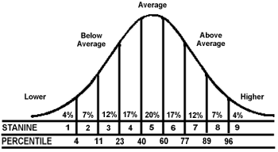
Therefore, what ???
Growth shows success in the education system because it shows us where positive change is happening for students and schools.
Florida’s model places the most emphasis on the lowest performing students in a school.
If the accountability system only includes proficiency, then schools will not get credit for moving low-performing students forward. There would be no incentive to work with the students that need the most help. …AND:
Including both proficiency and growth provides a much clearer picture of how the school is performing..

Slide 49
Therefore, what ???
* 61% = Sufficient * 39% = Not Sufficient
Growth shows success in the education system because it shows us where positive change is happening for students and schools.
Florida’s model places the most emphasis on the lowest performing students in a school.
If the accountability system only includes proficiency, then schools will not get credit for moving low-performing students forward. There would be no incentive to work with the students that need the most help. …AND:
Including both proficiency and growth provides a much clearer picture of how the school is performing..

Slide 50
Therefore, what ???
* 61% = Sufficient * 39% = Not Sufficient
Growth shows success in the education system because it shows us where positive change is happening for students and schools.
Florida’s model places the most emphasis on the lowest performing students in a school.
If the accountability system only includes proficiency, then schools will not get credit for moving low-performing students forward. There would be no incentive to work with the students that need the most help. …AND:
Including both proficiency and growth provides a much clearer picture of how the school is performing..

Slide 51
Therefore, what ???
* 61% = Sufficient * 39% = Not Sufficient
Growth shows success in the education system because it shows us where positive change is happening for students and schools.
Florida’s model places the most emphasis on the lowest performing students in a school.
If the accountability system only includes proficiency, then schools will not get credit for moving low-performing students forward. There would be no incentive to work with the students that need the most help. …AND:
* 61% = Sufficient * 39% = Not Sufficient
Including both proficiency and growth provides a much clearer picture of how the school is performing..

Slide 52
Therefore, what ???
* 61% = Sufficient * 39% = Not Sufficient
Growth shows success in the education system because it shows us where positive change is happening for students and schools.
Florida’s model places the most emphasis on the lowest performing students in a school.
If the accountability system only includes proficiency, then schools will not get credit for moving low-performing students forward. There would be no incentive to work with the students that need the most help. …AND:
* 61% = Sufficient * 39% = Not Sufficient
Including both proficiency and growth provides a much clearer picture of how the school is performing..

Slide 53
Therefore, what ???
* 61% = Sufficient * 39% = Not Sufficient
Growth shows success in the education system because it shows us where positive change is happening for students and schools.
Florida’s model places the most emphasis on the lowest performing students in a school.
If the accountability system only includes proficiency, then schools will not get credit for moving low-performing students forward. There would be no incentive to work with the students that need the most help. …AND:
* 61% = Sufficient * 39% = Not Sufficient
Including both proficiency and growth provides a much clearer picture of how the school is performing..
* 61% = Sufficient * 39% = Not Sufficient

Slide 54
Therefore, what ???
* 61% = Sufficient * 39% = Not Sufficient
Growth shows success in the education system because it shows us where positive change is happening for students and schools.
Florida’s model places the most emphasis on the lowest performing students in a school.
If the accountability system only includes proficiency, then schools will not get credit for moving low-performing students forward. There would be no incentive to work with the students that need the most help. …AND:
* 61% = Sufficient * 39% = Not Sufficient
Including both proficiency and growth provides a much clearer picture of how the school is performing..
* 61% = Sufficient * 39% = Not Sufficient

Slide 55
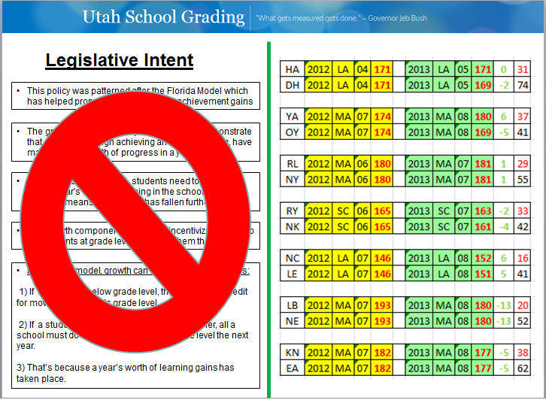
The Take away:
#1: “COMPLEX ALGORITHYM” from “R” Program
#2:
#3:
#4 Upcoming SAGE testing will only make things more Opaque

Slide 56
Some of the grades this year may surprise you. If that happens, the question to ask is, "Why did this school receive this grade?" As you dig deeper, the answers should be illuminating.
9m

Slide 57
“I expect resistance from some who are uncomfortable with transparency or opposed to reform”
Some of the grades this year may surprise you. If that happens, the question to ask is, "Why did this school receive this grade?" As you dig deeper, the answers should be illuminating.

Slide 58
1) Please look at helping to fix this during this session 2) We welcome any opportunities to work with the Legislature towards fixing this

